Slide 1

DATATHON FME 2023
Project Proposal
Here is where your presentation begins

Slide 2




TEAM MEMBERS
Diego Garcín
Pau Sabater Nácher
Physics Eng. and Industrial Eng.
Captivated by Generative AI
Mathematics & Physics Eng. student
Interested in Reinforcement Learning
Arnau Ollé
Ander Miranda
Mathematics student
Enthusiastic about the Optimization field
Mathematics and Data Eng. student
Machine learning passionate.

Slide 3
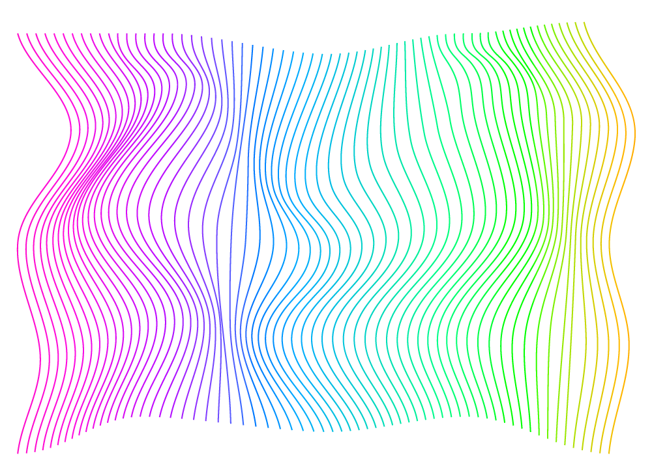
OBJECTIVE
Given a piece of clothing, find five fashionable outfits that include that pice.
We can access a database of fashionable outfits
We can access a database of the characteristics of different pieces of clothing

Slide 4

01
Data Exploration

Slide 5
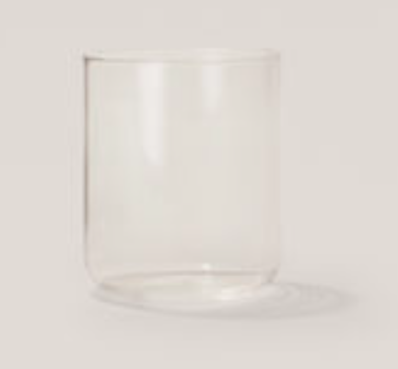
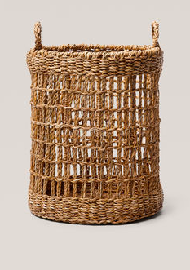


1.1. Overview of the dataset
Observations
Two different datasets
Useless elements for outfits composition
Key features and Characteristics
Structure of the data
Initial Insights
Relative frequencies of of different labels

Slide 6
Two different approaches
Deep Sequential Approach
Decision Learning
-
-Outfit generation
-Outfit selection

Slide 7
02
Deep Sequential Approach

Slide 8
2.3 Sequential approach architecture
Outfits data
Products database
Predictive Selector
Sub- dataset
Outfit generator
Proposed outfits
Deep Sequential Neural Network
Evaluated outfits
Best 5 outfits
Selector

Slide 9
2.3 Sequential approach architecture
Outfits data
Predictive Selector
-Graphs based
-Selects all the second grade neighbours
-Applyes an additional filter to further reduce the subdataset
Products database
Predictive Selector
Sub- dataset
Outfit generator
Proposed outfits
Deep Sequential Neural Network
Evaluated outfits
Best 5 outfits
Selector

Slide 10
2.3 Sequential approach architecture
Outfits data
Products database
Predictive Selector
Sub- dataset
Outfit generator
Proposed outfits
Deep Sequential Neural Network
Evaluated outfits
Best 5 outfits
Selector

Slide 11
2.3 Sequential approach architecture
Outfits data
Outfit generator
-Frequency based
-Fine tuning with hyperparameters
-Applies a first safety check
Products database
Predictive Selector
Sub- dataset
Outfit generator
Proposed outfits
Deep Sequential Neural Network
Evaluated outfits
Best 5 outfits
Selector

Slide 12
2.3 Sequential approach architecture
Outfits data
Products database
Predictive Selector
Sub- dataset
Outfit generator
Proposed outfits
Deep Sequential Neural Network
Evaluated outfits
Best 5 outfits
Selector

Slide 13
2.3 Sequential approach architecture
Outfits data
Deep Sequential Neural Network
-Binary approximation based approach
-Did Not take into account synergies
-Padding problems
Products database
Predictive Selector
Sub- dataset
Outfit generator
Proposed outfits
Evaluated outfits
Best 5 outfits
Selector

Slide 14
2.3 Sequential approach architecture
Outfits data
Products database
Predictive Selector
Sub- dataset
Outfit generator
Proposed outfits
Deep Sequential Neural Network
Evaluated outfits
Best 5 outfits
Selector

Slide 15
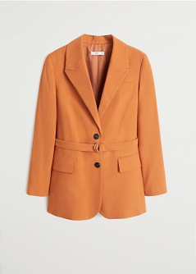
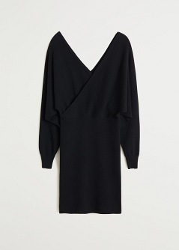
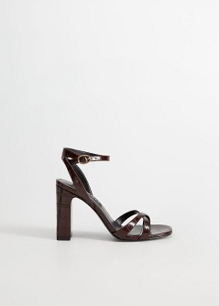
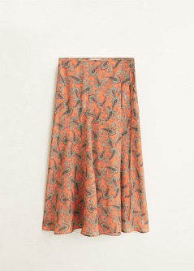
Results of the model

Slide 16
03
Decision Learning

Slide 17
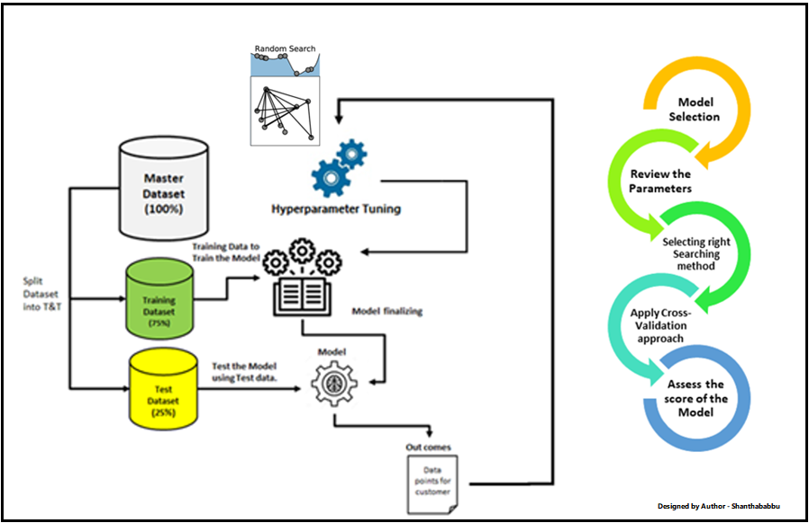

Slide 18
HYPERPARAMETER TUNNING
Advantages
A Decision Tree does not require scaling of data
Compared to other models, a Decision Tree requires less preparation of data (missing values in the data do not prevent the Decision Tree from making decisions)
Exploratory Data Analysis → Decision Trees can identify feature importance
Easy to interpret and explain
Disadvantages
Prone to overfitting
A lot of feature engineering may be required in order to optimize Decision Tree model
A single Decision Tree is usually a weak learner. Therefore, a Random Forest (made up of many Decision Trees) is often a better predictor
Gini Impurity or “entropy” for information gain.

Slide 19
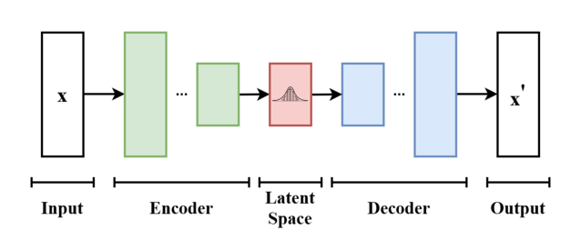
2.2. MODEL ARCHITECTURE
Descriptive ML model

Slide 20
Encoders
Encoder
00…01011 ⇒ 011
N x M
N x M/9
Decoder
10000100⇐ 268

Slide 21
2.2. MODEL ARCHITECTURE
Emulating creativity
Randomness

Slide 22
Decision Learning Model

Slide 23
Web Interface

Slide 24
Safety check
Using data analytics we found a series of rules all outfits follow.
Safety check function ensures proposed outfits follow those rules as well
1
model
SC
0

Slide 25
Results

Slide 26
RESOURCES
Did you like the resources on this template? Get them for free at our other websites:
Libraries & Models
fstream
csv.h
streamlit
pandas
os
numpy
Sequential
Dense
train_test_split
StandarsScalers
References & Ideas
https://ibm.com/topics/supervised-learning
https://www.ibm.com/topics/unsupervised-learning

Slide 27
Thank you !
We would love to answer your questions

